Slide 1
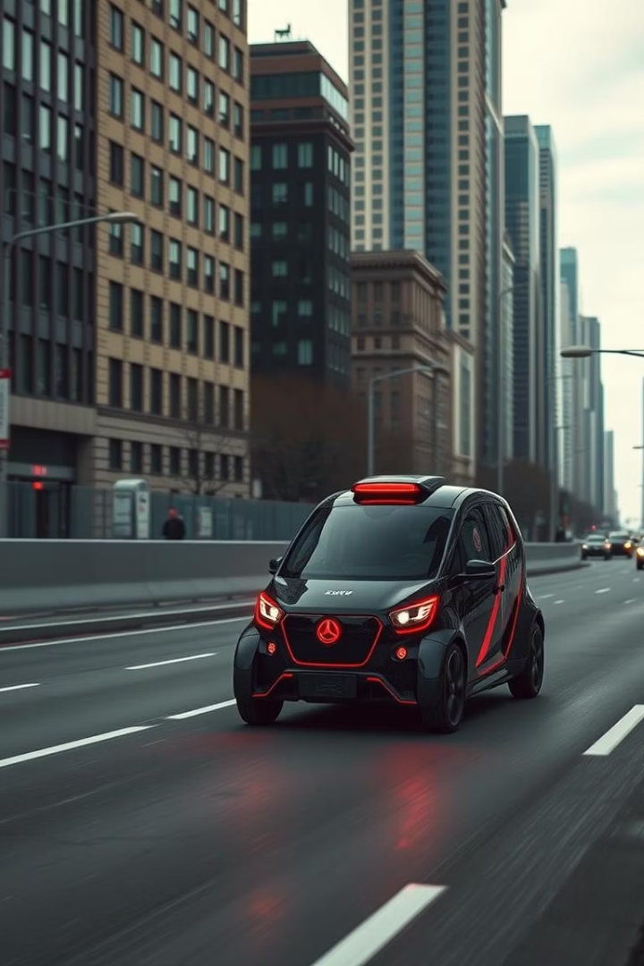
Real-Time Object Detection for Autonomous Vehicles
Enhancing safety and situational awareness in autonomous driving systems.

Slide 2
Project Overview
Objectives
Key Goals
Detect pedestrians, vehicles, traffic signs
Enhance safety
Real-time object classification
Improve decision-making
Challenges
Varying lighting and weather
Real-time processing constraints
Class imbalance and diverse data

Slide 3
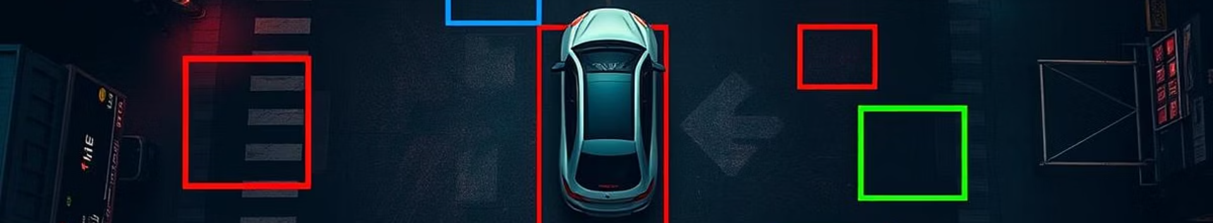
Milestone 1: Data Collection & Preprocessing
Dataset
Completed
Pending
Roboflow Self-Driving Cars, YOLOv11 format
Download and structured dataset
Data exploration: class distribution, sample images
Train-test split performed
Augmentation: flips, rotations, brightness adjustment

Slide 4
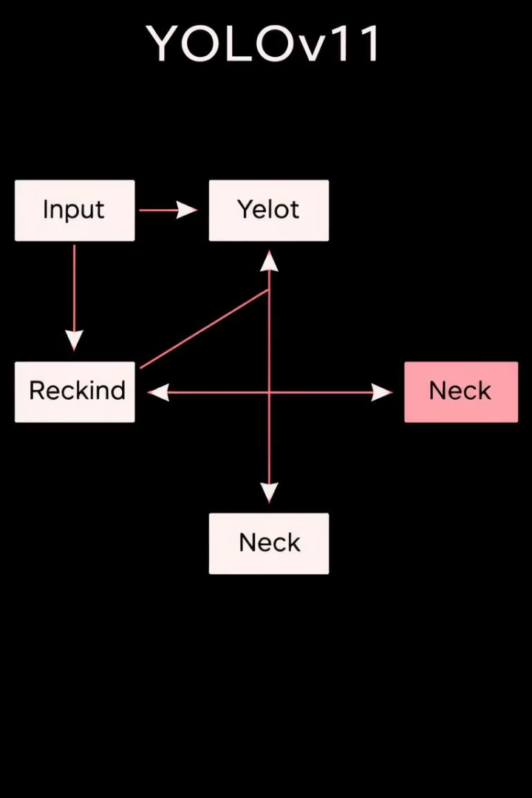
Milestone 2: Model Development
Model Choice
Reasons
YOLOv11 by Ultralytics
High speed and accuracy
Ideal for real-time deployment
Process
YAML config defined
Training directories prepared
Training and tuning upcoming

Slide 5
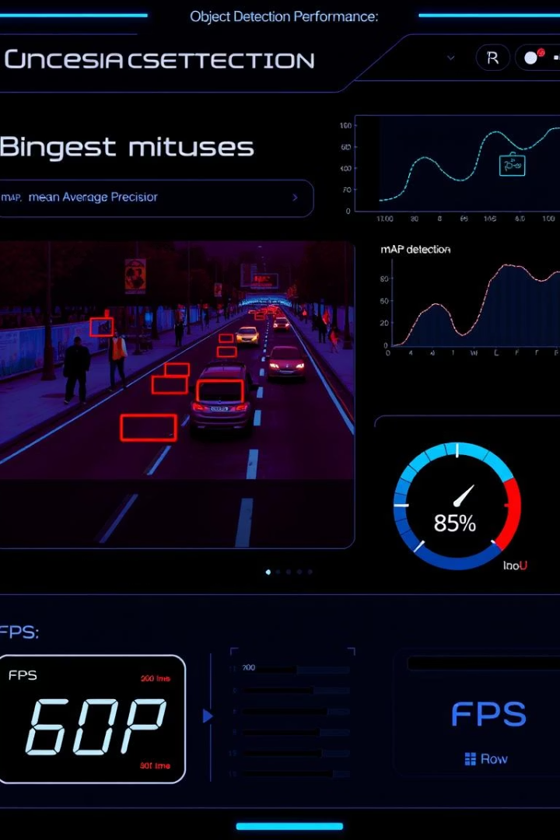
Evaluation Metrics
mAP
mean Average Precision for detection accuracy
IoU
Intersection over Union to evaluate bounding boxes
FPS
Frames Per Second, measuring real-time speed
Goal
Balance between accuracy and real-time performance

Slide 6

Milestone 3: Deployment & Real-Time Testing
Testing
Integration
Evaluate performance in various conditions
Model Conversion
Connect model to real-time camera feed
Convert to ONNX or TensorFlow Lite for edge deployment
Day/night, highway, urban scenarios

Slide 7
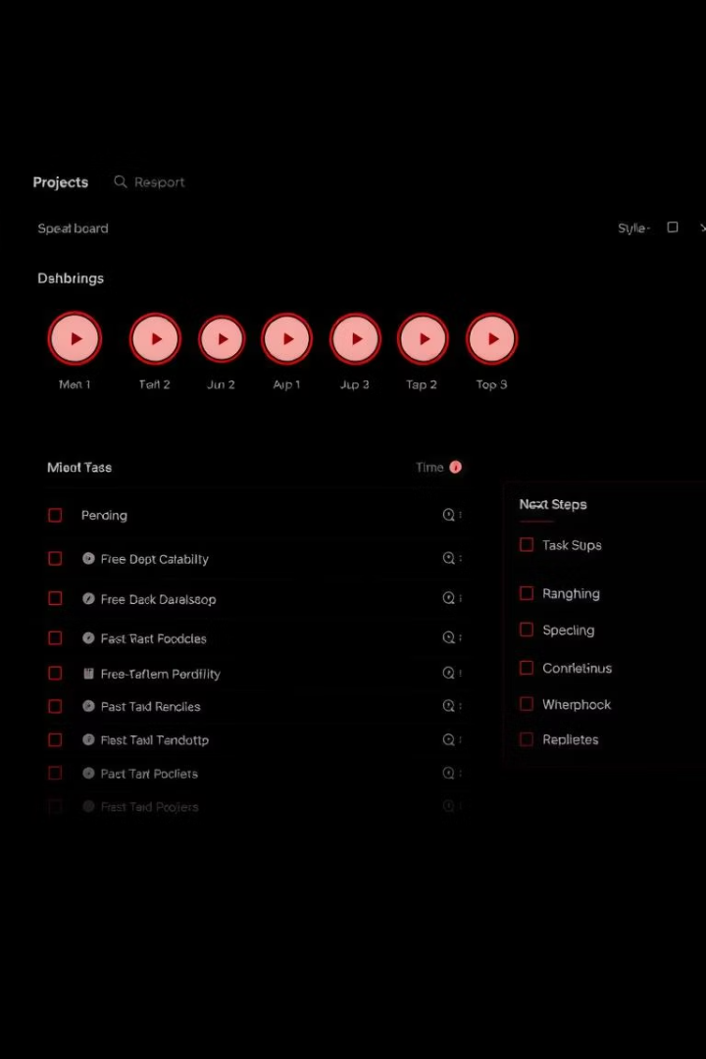
Current Progress Summary
✔ Dataset downloaded and split
⚠ Missing data analysis, augmentations, training logs
⏳ Next: Visualization, augmentation, training start
Prepare deployment pipeline

Slide 8
Thank You
Q&A
Contact Info
Open for questions and discussion
Email: Mahmoud.Nasr20@faci.usc.edu.e
GitHub: github.com/MahmoudNasrAly
LinkedIn: linkedin.com/in/MahmoudNasrAly

Slide 9
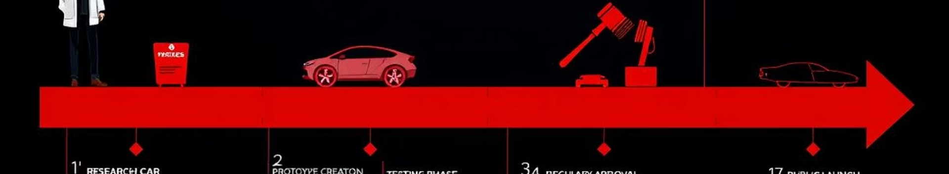




Summary & Next Steps
Complete Data Analysis
Enhance Augmentation
Train & Validate Model
Deploy & Test
Real-world environment evaluation
Explore dataset, inspect class balance
Increase model robustness
Optimize accuracy and speed

